Slide 1

CS 332: Algorithms
Asymptotic Performance

Slide 2
Review: Asymptotic Performance
Asymptotic performance: How does algorithm behave as the problem size gets very large?
    Running time
    Memory/storage requirements
  Remember that we use the RAM model:
    All memory equally expensive to access
    No concurrent operations
    All reasonable instructions take unit time
      Except, of course, function calls
    Constant word size
      Unless we are explicitly manipulating bits

Slide 3
Review: Running Time
Number of primitive steps that are executed
  Except for time of executing a function call most statements roughly require the same amount of time
  We can be more exact if need be
Worst case vs. average case

Slide 4
An Example: Insertion Sort
InsertionSort(A, n) {
for i = 2 to n {
key = A[i]
j = i - 1;
while (j > 0) and (A[j] > key) {
A[j+1] = A[j]
j = j - 1
}
A[j+1] = key
}
}

Slide 5
An Example: Insertion Sort
30
10
40
20
i = ∅ j = ∅ key = ∅
A[j] = ∅ A[j+1] = ∅
1
2
3
4
InsertionSort(A, n) {
for i = 2 to n {
key = A[i]
j = i - 1;
while (j > 0) and (A[j] > key) {
A[j+1] = A[j]
j = j - 1
}
A[j+1] = key
}
}

Slide 6
An Example: Insertion Sort
30
10
40
20
i = 2 j = 1 key = 10
A[j] = 30 A[j+1] = 10
1
2
3
4
InsertionSort(A, n) {
for i = 2 to n {
key = A[i]
j = i - 1;
while (j > 0) and (A[j] > key) {
A[j+1] = A[j]
j = j - 1
}
A[j+1] = key
}
}

Slide 7
An Example: Insertion Sort
30
30
40
20
i = 2 j = 1 key = 10
A[j] = 30 A[j+1] = 30
1
2
3
4
InsertionSort(A, n) {
for i = 2 to n {
key = A[i]
j = i - 1;
while (j > 0) and (A[j] > key) {
A[j+1] = A[j]
j = j - 1
}
A[j+1] = key
}
}

Slide 8
An Example: Insertion Sort
30
30
40
20
i = 2 j = 1 key = 10
A[j] = 30 A[j+1] = 30
1
2
3
4
InsertionSort(A, n) {
for i = 2 to n {
key = A[i]
j = i - 1;
while (j > 0) and (A[j] > key) {
A[j+1] = A[j]
j = j - 1
}
A[j+1] = key
}
}

Slide 9
An Example: Insertion Sort
30
30
40
20
i = 2 j = 0 key = 10
A[j] = ∅ A[j+1] = 30
1
2
3
4
InsertionSort(A, n) {
for i = 2 to n {
key = A[i]
j = i - 1;
while (j > 0) and (A[j] > key) {
A[j+1] = A[j]
j = j - 1
}
A[j+1] = key
}
}

Slide 10
An Example: Insertion Sort
30
30
40
20
i = 2 j = 0 key = 10
A[j] = ∅ A[j+1] = 30
1
2
3
4
InsertionSort(A, n) {
for i = 2 to n {
key = A[i]
j = i - 1;
while (j > 0) and (A[j] > key) {
A[j+1] = A[j]
j = j - 1
}
A[j+1] = key
}
}

Slide 11
An Example: Insertion Sort
10
30
40
20
i = 2 j = 0 key = 10
A[j] = ∅ A[j+1] = 10
1
2
3
4
InsertionSort(A, n) {
for i = 2 to n {
key = A[i]
j = i - 1;
while (j > 0) and (A[j] > key) {
A[j+1] = A[j]
j = j - 1
}
A[j+1] = key
}
}

Slide 12
An Example: Insertion Sort
10
30
40
20
i = 3 j = 0 key = 10
A[j] = ∅ A[j+1] = 10
1
2
3
4
InsertionSort(A, n) {
for i = 2 to n {
key = A[i]
j = i - 1;
while (j > 0) and (A[j] > key) {
A[j+1] = A[j]
j = j - 1
}
A[j+1] = key
}
}

Slide 13
An Example: Insertion Sort
10
30
40
20
i = 3 j = 0 key = 40
A[j] = ∅ A[j+1] = 10
1
2
3
4
InsertionSort(A, n) {
for i = 2 to n {
key = A[i]
j = i - 1;
while (j > 0) and (A[j] > key) {
A[j+1] = A[j]
j = j - 1
}
A[j+1] = key
}
}

Slide 14
An Example: Insertion Sort
10
30
40
20
i = 3 j = 0 key = 40
A[j] = ∅ A[j+1] = 10
1
2
3
4
InsertionSort(A, n) {
for i = 2 to n {
key = A[i]
j = i - 1;
while (j > 0) and (A[j] > key) {
A[j+1] = A[j]
j = j - 1
}
A[j+1] = key
}
}

Slide 15
An Example: Insertion Sort
10
30
40
20
i = 3 j = 2 key = 40
A[j] = 30 A[j+1] = 40
1
2
3
4
InsertionSort(A, n) {
for i = 2 to n {
key = A[i]
j = i - 1;
while (j > 0) and (A[j] > key) {
A[j+1] = A[j]
j = j - 1
}
A[j+1] = key
}
}

Slide 16
An Example: Insertion Sort
10
30
40
20
i = 3 j = 2 key = 40
A[j] = 30 A[j+1] = 40
1
2
3
4
InsertionSort(A, n) {
for i = 2 to n {
key = A[i]
j = i - 1;
while (j > 0) and (A[j] > key) {
A[j+1] = A[j]
j = j - 1
}
A[j+1] = key
}
}

Slide 17
An Example: Insertion Sort
10
30
40
20
i = 3 j = 2 key = 40
A[j] = 30 A[j+1] = 40
1
2
3
4
InsertionSort(A, n) {
for i = 2 to n {
key = A[i]
j = i - 1;
while (j > 0) and (A[j] > key) {
A[j+1] = A[j]
j = j - 1
}
A[j+1] = key
}
}

Slide 18
An Example: Insertion Sort
10
30
40
20
i = 4 j = 2 key = 40
A[j] = 30 A[j+1] = 40
1
2
3
4
InsertionSort(A, n) {
for i = 2 to n {
key = A[i]
j = i - 1;
while (j > 0) and (A[j] > key) {
A[j+1] = A[j]
j = j - 1
}
A[j+1] = key
}
}

Slide 19
An Example: Insertion Sort
10
30
40
20
i = 4 j = 2 key = 20
A[j] = 30 A[j+1] = 40
1
2
3
4
InsertionSort(A, n) {
for i = 2 to n {
key = A[i]
j = i - 1;
while (j > 0) and (A[j] > key) {
A[j+1] = A[j]
j = j - 1
}
A[j+1] = key
}
}

Slide 20
An Example: Insertion Sort
10
30
40
20
i = 4 j = 2 key = 20
A[j] = 30 A[j+1] = 40
1
2
3
4
InsertionSort(A, n) {
for i = 2 to n {
key = A[i]
j = i - 1;
while (j > 0) and (A[j] > key) {
A[j+1] = A[j]
j = j - 1
}
A[j+1] = key
}
}

Slide 21
An Example: Insertion Sort
10
30
40
20
i = 4 j = 3 key = 20
A[j] = 40 A[j+1] = 20
1
2
3
4
InsertionSort(A, n) {
for i = 2 to n {
key = A[i]
j = i - 1;
while (j > 0) and (A[j] > key) {
A[j+1] = A[j]
j = j - 1
}
A[j+1] = key
}
}

Slide 22
An Example: Insertion Sort
10
30
40
20
i = 4 j = 3 key = 20
A[j] = 40 A[j+1] = 20
1
2
3
4
InsertionSort(A, n) {
for i = 2 to n {
key = A[i]
j = i - 1;
while (j > 0) and (A[j] > key) {
A[j+1] = A[j]
j = j - 1
}
A[j+1] = key
}
}

Slide 23
An Example: Insertion Sort
10
30
40
40
i = 4 j = 3 key = 20
A[j] = 40 A[j+1] = 40
1
2
3
4
InsertionSort(A, n) {
for i = 2 to n {
key = A[i]
j = i - 1;
while (j > 0) and (A[j] > key) {
A[j+1] = A[j]
j = j - 1
}
A[j+1] = key
}
}

Slide 24
An Example: Insertion Sort
10
30
40
40
i = 4 j = 3 key = 20
A[j] = 40 A[j+1] = 40
1
2
3
4
InsertionSort(A, n) {
for i = 2 to n {
key = A[i]
j = i - 1;
while (j > 0) and (A[j] > key) {
A[j+1] = A[j]
j = j - 1
}
A[j+1] = key
}
}

Slide 25
An Example: Insertion Sort
10
30
40
40
i = 4 j = 3 key = 20
A[j] = 40 A[j+1] = 40
1
2
3
4
InsertionSort(A, n) {
for i = 2 to n {
key = A[i]
j = i - 1;
while (j > 0) and (A[j] > key) {
A[j+1] = A[j]
j = j - 1
}
A[j+1] = key
}
}

Slide 26
An Example: Insertion Sort
10
30
40
40
i = 4 j = 2 key = 20
A[j] = 30 A[j+1] = 40
1
2
3
4
InsertionSort(A, n) {
for i = 2 to n {
key = A[i]
j = i - 1;
while (j > 0) and (A[j] > key) {
A[j+1] = A[j]
j = j - 1
}
A[j+1] = key
}
}

Slide 27
An Example: Insertion Sort
10
30
40
40
i = 4 j = 2 key = 20
A[j] = 30 A[j+1] = 40
1
2
3
4
InsertionSort(A, n) {
for i = 2 to n {
key = A[i]
j = i - 1;
while (j > 0) and (A[j] > key) {
A[j+1] = A[j]
j = j - 1
}
A[j+1] = key
}
}

Slide 28
An Example: Insertion Sort
10
30
30
40
i = 4 j = 2 key = 20
A[j] = 30 A[j+1] = 30
1
2
3
4
InsertionSort(A, n) {
for i = 2 to n {
key = A[i]
j = i - 1;
while (j > 0) and (A[j] > key) {
A[j+1] = A[j]
j = j - 1
}
A[j+1] = key
}
}

Slide 29
An Example: Insertion Sort
10
30
30
40
i = 4 j = 2 key = 20
A[j] = 30 A[j+1] = 30
1
2
3
4
InsertionSort(A, n) {
for i = 2 to n {
key = A[i]
j = i - 1;
while (j > 0) and (A[j] > key) {
A[j+1] = A[j]
j = j - 1
}
A[j+1] = key
}
}

Slide 30
An Example: Insertion Sort
10
30
30
40
i = 4 j = 1 key = 20
A[j] = 10 A[j+1] = 30
1
2
3
4
InsertionSort(A, n) {
for i = 2 to n {
key = A[i]
j = i - 1;
while (j > 0) and (A[j] > key) {
A[j+1] = A[j]
j = j - 1
}
A[j+1] = key
}
}

Slide 31
An Example: Insertion Sort
10
30
30
40
i = 4 j = 1 key = 20
A[j] = 10 A[j+1] = 30
1
2
3
4
InsertionSort(A, n) {
for i = 2 to n {
key = A[i]
j = i - 1;
while (j > 0) and (A[j] > key) {
A[j+1] = A[j]
j = j - 1
}
A[j+1] = key
}
}

Slide 32
An Example: Insertion Sort
10
20
30
40
i = 4 j = 1 key = 20
A[j] = 10 A[j+1] = 20
1
2
3
4
InsertionSort(A, n) {
for i = 2 to n {
key = A[i]
j = i - 1;
while (j > 0) and (A[j] > key) {
A[j+1] = A[j]
j = j - 1
}
A[j+1] = key
}
}

Slide 33
An Example: Insertion Sort
10
20
30
40
i = 4 j = 1 key = 20
A[j] = 10 A[j+1] = 20
1
2
3
4
InsertionSort(A, n) {
for i = 2 to n {
key = A[i]
j = i - 1;
while (j > 0) and (A[j] > key) {
A[j+1] = A[j]
j = j - 1
}
A[j+1] = key
}
}
Done!

Slide 34
Animating Insertion Sort
Check out the Animator, a java applet at:
http://www.cs.hope.edu/~alganim/animator/Animator.html
Try it out with random, ascending, and descending inputs

Slide 35
Insertion Sort
What is the precondition
for this loop?
InsertionSort(A, n) {
for i = 2 to n {
key = A[i]
j = i - 1;
while (j > 0) and (A[j] > key) {
A[j+1] = A[j]
j = j - 1
}
A[j+1] = key
}
}

Slide 36
Insertion Sort
InsertionSort(A, n) {
for i = 2 to n {
key = A[i]
j = i - 1;
while (j > 0) and (A[j] > key) {
A[j+1] = A[j]
j = j - 1
}
A[j+1] = key
}
}
How many times will
this loop execute?

Slide 37
Insertion Sort
Statement Effort
InsertionSort(A, n) {
for i = 2 to n { c₁n
key = A[i] c₂(n-1)
j = i - 1; c₃(n-1)
while (j > 0) and (A[j] > key) { c₄T
A[j+1] = A[j] c₅(T-(n-1))
j = j - 1 c₆(T-(n-1))
} 0
A[j+1] = key c₇(n-1)
} 0
}
T = t₂ + t₃ + … + t_{n} where t_{i} is number of while expression evaluations for the i^{th} for loop iteration

Slide 38
Analyzing Insertion Sort
T(n) = c₁n + c₂(n-1) + c₃(n-1) + c₄T + c₅(T - (n-1)) + c₆(T - (n-1)) + c₇(n-1)
= c₈T + c₉n + c₁₀
What can T be?
  Best case -- inner loop body never executed
    t_{i} = 1 ➔ T(n) is a linear function
  Worst case -- inner loop body executed for all previous elements
    t_{i} = i ➔ T(n) is a quadratic function
  Average case
    ???

Slide 39
Analysis
Simplifications
  Ignore actual and abstract statement costs
  Order of growth is the interesting measure:
    Highest-order term is what counts
      Remember, we are doing asymptotic analysis
      As the input size grows larger it is the high order term that dominates

Slide 40
Upper Bound Notation
We say InsertionSort’s run time is O(n²)
  Properly we should say run time is in O(n²)
  Read O as “Big-O” (you’ll also hear it as “order”)
In general a function
  f(n) is O(g(n)) if there exist positive constants c and n₀ such that f(n) ≤ c ⋅ g(n) for all n ≥ n₀
Formally
  O(g(n)) = { f(n): ∃ positive constants c and n₀ such that f(n) ≤ c ⋅ g(n) ∀ n ≥ n₀

Slide 41
Insertion Sort Is O(n²)
Proof
  Suppose runtime is an² + bn + c
    If any of a, b, and c are less than 0 replace the constant with its absolute value
  an² + bn + c ≤ (a + b + c)n² + (a + b + c)n + (a + b + c)
  ≤ 3(a + b + c)n² for n ≥ 1
  Let c’ = 3(a + b + c) and let n₀ = 1
Question
  Is InsertionSort O(n³)?
  Is InsertionSort O(n)?

Slide 42
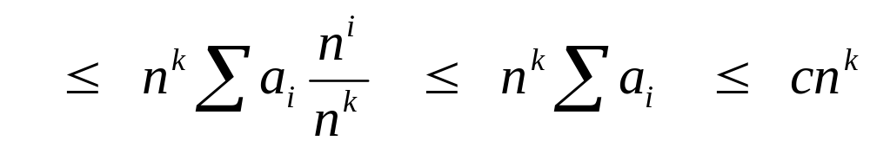
Big O Fact
A polynomial of degree k is O(n^{k})
Proof:
  Suppose f(n) = b_{k}n^{k} + b_{k-1}n^{k-1} + … + b₁n + b₀
    Let a_{i} = | b_{i} |
  f(n) ≤ a_{k}n^{k} + a_{k-1}n^{k-1} + … + a₁n + a₀

Slide 43
Lower Bound Notation
We say InsertionSort’s run time is Ω(n)
In general a function
  f(n) is Ω(g(n)) if ∃ positive constants c and n₀ such that 0 ≤ c⋅g(n) ≤ f(n) ∀ n ≥ n₀
Proof:
  Suppose run time is an + b
    Assume a and b are positive (what if b is negative?)
  an ≤ an + b

Slide 44
Asymptotic Tight Bound
A function f(n) is Θ(g(n)) if ∃ positive constants c₁, c₂, and n₀ such that
c₁ g(n) ≤ f(n) ≤ c₂ g(n) ∀ n ≥ n₀
Theorem
  f(n) is Θ(g(n)) iff f(n) is both O(g(n)) and Ω(g(n))
  Proof: someday

Slide 45

Practical Complexity

Slide 46

Practical Complexity

Slide 47

Practical Complexity

Slide 48

Practical Complexity

Slide 49
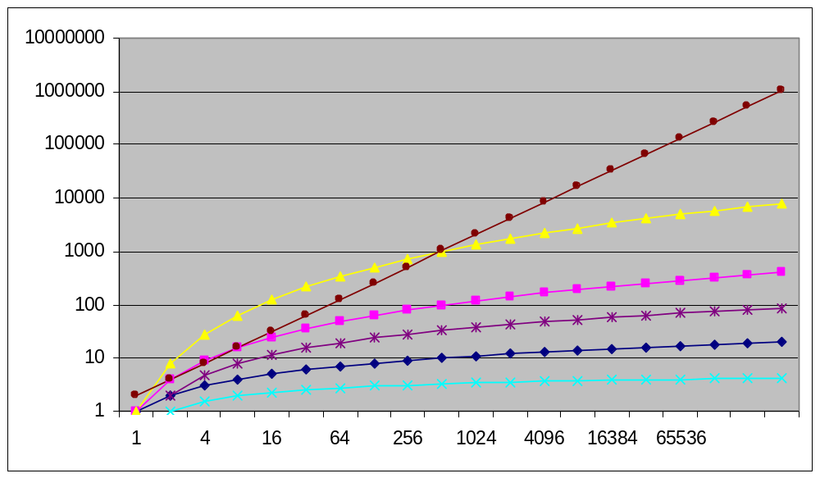
Practical Complexity

Slide 50
Other Asymptotic Notations
A function f(n) is o(g(n)) if ∃ positive constants c and n₀ such that
f(n) < c g(n) ∀ n ≥ n₀
A function f(n) is ω(g(n)) if ∃ positive constants c and n₀ such that
c g(n) < f(n) ∀ n ≥ n₀
Intuitively,
  o() is like <
  O() is like ≤
  ω() is like >
  Ω() is like ≥
  Θ() is like =

Slide 51
Up Next
Solving recurrences
  Substitution method
  Master theorem

